Slide 1
Air pollution in india

Slide 2
Team members
Harini Mohan
K Poojita Lakshya Syamala
Ch.Sandhya Niharika

Slide 3
CONtents
Abstract
Python packages used
States having most pollution
Pollutants monitored
Conclusion

Slide 4
abstract
This data belongs to the Indian GOVT description of data . the real time data as collected from the field instruments is displayed live without human intervention from cpcb . It contains real time national air quality index values from different monitoring stations across india

Slide 5
Python packages used
Pandas
Numpy
Matplotlib.pyplot
Seaborn

Slide 6
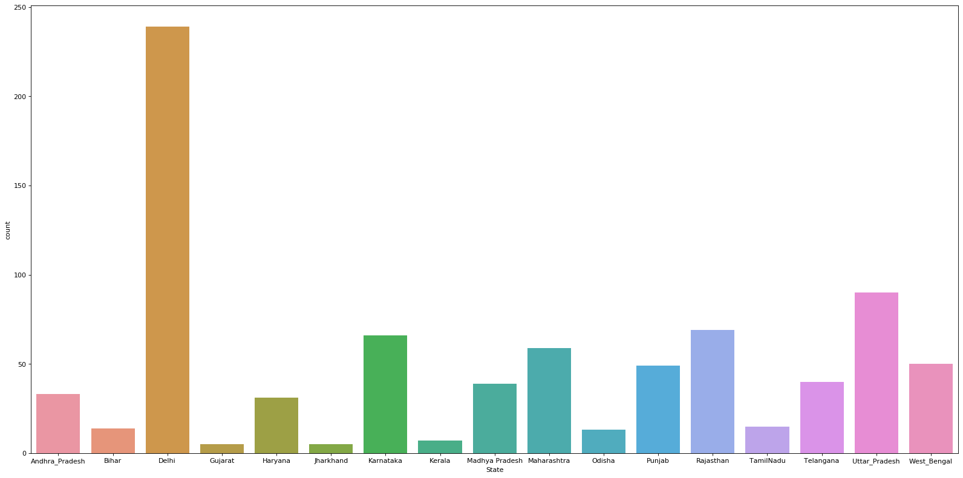
Checking which state have most pollution
We got that Delhi is most polluted and Gujarat and Jharkhand are least polluted

Slide 7
As per graph plotted
Sulphur Dioxide (SO2)
Nitrogen Dioxide (NO2)
Particular Matter (PM10 and PM2.5)
Carbon Monoxide(CO)
Oxide(O3)
Pollutants that are monitored

Slide 8
Conclusion
From the analysis,we can see that major affected areas in india by air pollution belong to the northern region
The reason for the decrease could be awareness in citizens and government policies

